Slide 1

Customer Segmentation
Analysing Prism’s Customer Base
Team Yellow
Beauchamp, Charlie, Jude, Mohammad, Nazmie & Rayan
Notes:
[Hello, who we are, what we are presenting]

Slide 2
KPIs
Average User Spend per Order
Average User Frequency
Average Customer Life Value
% of User Opt-Ins
Calculate these KPIs for each segment.
Compare how the behaviours of each customer segment have changed over time.
Notes:
[Walk through each KPI]
We would calculate the KPI values for each segment for EACH year. This would help us not only make comparisons between the different segments but would also enable us to see how the customer segments behaved year-on-year.

Slide 3
Improve Personalisation of Marketing Emails
Goal
Strategy
Objectives
Tactic
Maximise value from current single and low purchase customers.
Convert the low value customers to high value - (from lower groups of 2 - 5 to group 6 of our RFM model)
Customer acquisition and retention
Maximise the customer base and their engagement
Improve new customer marketing engagement
Increase email opt-in rate for new customers with first sign up offers of 10% & further exclusive email offers for account holders
Create a customer segmentation
Divide the customer base according to groups specified in our RFM model for targeted marketing.
Notes:
Our first step was to identify our GSOT plan to ensure that our work would have a positive impact for the business and aligns with Prism’s mission of becoming a global leader in e-commerce for affordable fashion
[Walk through each step]

Slide 4
Assumptions
By ignoring all guest customers we can still create a valuable segmentation.
Hypothesised that segment with the same tally score would have similar KPI values, and grouped these segments together.
Most customer emails are being received, read and interacted with.
Limitations
Cookie ID cannot be reliably used to uniquely identify guest customers.
Lack of data in customers table prevents calculation of guest opt-in %.
Our method for deriving the segments restricted the use of a slider to analyse/compare KPI values.
Notes:
We made a unanimous decision to ignore guest customers with good reason, but we believe the segmentation created is still incredibly valuable
We believe the tally score resulted from our RFM model would have similar KPI values assigned and such we have grouped these segments accordingly
We are assuming customer emails are being received, read and interacted with and not being sent to junk/spam in error

Slide 5
Modified RFM Segmentation
Segmenting via Frequency of Orders and Average Value of Orders
Score | Frequency | Monetary
1 | 1 | 0-33%
2 | 2-9 | 33-66%
3 | 10+ | 66%-100%
Notes:
Our approach was to use our own modified version of a RFM segmentation that segmented our customer base by looking at the number of orders and the total spend per customer, so frequency and monetary value.
For each variable we would assign each customer a value between 1 and 3, and would sum these two scores for each customer to give a tally score. Customers with the same tally score were placed into the same segment, giving us a total of 5 different segments.
By comparing the values of KPIs for each segment per fiscal year, we believed that we would adequately cover the recency part of a typical RFM segmentation.

Slide 6
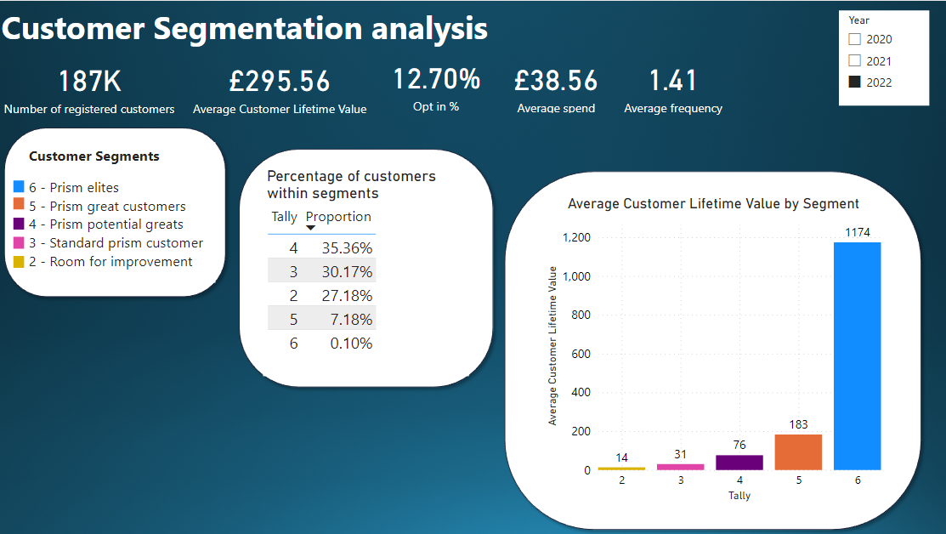
Dashboard Overview
Notes:
This dashboard displays KPI’s and insights from the year 2022
Biggest customer segment is prism potential greats followed by standard prism customer( we want to move these customers up into prism elites)
This is because when we look at customer lifetime value prism elites generate £1174 - considerably bigger than the other segments
Customer segment room for improvement account to over ¼ of our customers and their average CLV is extremely low so we want a very negligible amount here

Slide 7
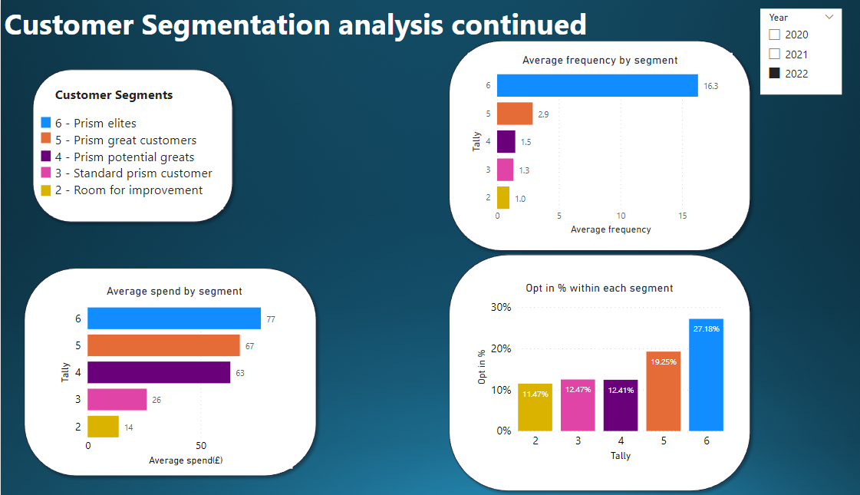
Notes:
Average spend per order segments 6-4 very little difference however when placed against frequency we can see the issue with prism great and prism potential greats is that that just aren’t ordering frequently enough on average.
Segment 2 &3 on average spend 50-60£ less than our target segment(segment 6) so we would need to find ways to increase their spending particularly
Segments 2-5 on average have a low user frequency so room for improvement for all
Opt in % - room for improvement across the board

Slide 8
Recommendations
Increase Frequency (push group 4 -> 5) - get 20% off with 3rd order
Increase Spend (push group 3 -> 4) spend £50+ for free delivery
To push group 2 upwards:-
Return Coupons, Multivariate Test:
£5 Voucher
10% off
1 in 10,000 chance to win a Tesla Model 3
Email Incentives, A/B Testing:
Item of the week 50% off
Pre-order availability for new drops through email
Notes:
1st point - because group 4 contributes mostly by number of purchases
2nd point - because group 3 contributes mostly by purchasing amount
3rd point - We could conduct multivariate testing to see the impact of implementing the following incentives
4th point - We can also conduct A/B testing to see the impact of implementing one of the following perks

Slide 9
Appendix
Our Workings - Google Excel Sheets:
https://rb.gy/ngp9e3
Our Power BI Dashboard:
https://rb.gy/j0ruvc

Slide 10
Thank you
Questions & Feedback welcome

